Slide 1
Autonomous Proposal Document Creator Platform
Corporate Proposal Draft
Draft Date: July 2026

Slide 2
Business Summary
Executive overview of the proposed solution
The proposed Unit-Test Case Generator Agent project aims to revolutionize software quality assurance by generating requirement-aligned unit test cases from design documents and user stories before development begins. This proactive approach ensures that tests guide implementation, reducing the risk of undetected business logic gaps. The strategic benefits include enhanced software reliability, reduced defect rates, and accelerated time-to-market. By integrating this solution into existing workflows, development teams can focus on delivering high-quality code from the outset, leading to significant operational efficiencies and a competitive edge in the market.
Solution Advisory | Autonomous Bid Lifecycle Platform | AI Draft - For Internal Review Only

Slide 3
Client Requirements & Gap Analysis
RAG-driven competence matching against RFP requirements
Key Client Requirements:
• Deliver high-performance React front-end application with state management.
• Establish secure, authenticated JSON APIs with low latency.
• Set up secure containerized database configuration with audit trails.
• Implement automated DevOps workflows, CI/CD, and security vulnerability scanning.
• Adhere to delivery target timeline.
Solution Advisory | Autonomous Bid Lifecycle Platform | AI Draft - For Internal Review Only

Slide 4
Capability Gaps & Mitigations
Identified gaps against RFP requirements and proposed mitigations
Capability Gaps & Mitigations:
• Identified gap in Client Requirement: 'Deliver high-performance React front-end application with state management.'. Mitigation: To mitigate our current lack of expertise in React and state management, we will recruit a specialist contractor to ensure the successful delivery of this project.
• Identified gap in Client Requirement: 'Establish secure, authenticated JSON APIs with low latency.'. Mitigation: To mitigate our current limitations, we can partner with a specialized API development firm to ensure the delivery of secure, authenticated JSON APIs with low latency.
• Identified gap in Client Requirement: 'Set up secure containerized database configuration with audit trails.'. Mitigation: To mitigate our current lack of expertise in this area, we will recruit a specialist contractor with experience in setting up secure containerized database configurations and implementing audit trails.
• Identified gap in Client Requirement: 'Implement automated DevOps workflows, CI/CD, and security vulnerability scanning.'. Mitigation: To mitigate our current limitations in meeting this requirement, we will partner with a specialized DevOps consulting firm to augment our capabilities during the initial implementation phase.
• Identified gap in Client Requirement: 'Adhere to delivery target timeline.'. Mitigation: To mitigate the risk of not meeting the delivery target timeline, we can engage an external project management consultant who specializes in expediting complex projects.
Solution Advisory | Autonomous Bid Lifecycle Platform | AI Draft - For Internal Review Only

Slide 5
Capability Gaps & Mitigations
Identified gaps against RFP requirements and proposed mitigations
Capability Gaps & Mitigations:
• Identified gap in Client Requirement: 'Security and Data Protection'. Mitigation: Implement enterprise-grade zero-trust architecture, advanced data encryption, RBAC, and continuous threat detection mechanisms.
• Identified gap in Client Requirement: 'System Observability and Monitoring'. Mitigation: Deploy comprehensive distributed tracing, centralized logging, and real-time alerting dashboards across the multi-agent environment.
Solution Advisory | Autonomous Bid Lifecycle Platform | AI Draft - For Internal Review Only

Slide 6
Solution Approach & Architecture
High-level implementation strategy and operational frameworks
01. Enhanced Software Quality
02. Streamlined Development Process
03. Operational Efficiency and Cost Savings
The solution generates unit test cases directly from requirements, ensuring comprehensive coverage of business logic. This proactive approach reduces defects and improves overall software reliability.
By integrating requirement-driven TDD principles, the solution accelerates development cycles. Teams can generate tests before or during implementation, guiding code development more effectively.
Automated test generation reduces manual effort, allowing teams to focus on high-value tasks. This leads to faster delivery times and lower operational costs, enhancing overall productivity.
Solution Advisory | Autonomous Bid Lifecycle Platform | AI Draft - For Internal Review Only

Slide 7
High Level Design: Data Flow
User uploads requirement and design artifacts.
▼
Artifacts are processed to extract relevant information.
▼
Unit tests are generated based on extracted requirements.
▼
Generated tests are reviewed and packaged for implementation.

Slide 8
Landscape & Architecture
Reference systems architecture and integration patterns
Presentation layer (UI Client)
Web UI
State Management
Application Logic (API Backend)
Core API Server
Auth Service
Artifact Intake Agent
Requirement Decomposition Agent
Service Decomposition Agent
Test Case Design Agent
Coverage Reviewer
Output Agent
Data Integration & Cache Layer
Database
Object Storage
Message Queue
Cache
Solution Advisory | Autonomous Bid Lifecycle Platform | AI Draft - For Internal Review Only

Slide 9
Infrastructure Approximation
Estimated cloud infrastructure components and costs
Azure Component | Specification | Unit Cost
Azure App Service | 2x Standard S1 instances | $ $300 onwards per hour
Azure API Management | Standard tier, 4 units | $ $500 onwards per hour
Azure Cache for Redis | 2x Standard C1 instances | $ $350 onwards per hour
Azure Blob Storage | 10 TB LRS storage, 1 GB read/write | $ $400 onwards per hour
Azure PostgreSQL Database | 2x General Purpose, 8 vCores | $ $650 onwards per hour
Solution Advisory | Autonomous Bid Lifecycle Platform | AI Draft - For Internal Review Only

Slide 10
Project Milestones
Sequential delivery phases and target deliverables
Design & Planning
Key Deliverables / Activities:
Project planning, requirements gathering, and initial design.
Development
Key Deliverables / Activities:
Front-end development with React, state management implementation, secure API setup, containerized database configuration, and DevOps workflows.
Testing
Key Deliverables / Activities:
Unit testing, integration testing, performance testing, and security testing.
Deployment
Key Deliverables / Activities:
Application deployment to production environment.
Training
Key Deliverables / Activities:
End-user training and documentation.
Solution Advisory | Autonomous Bid Lifecycle Platform | AI Draft - For Internal Review Only

Slide 11
Effort & Person-Hour Conversion
Allocated program FTE structure, rate cards, and financial sizing
Role / Competency | Hourly Rate | Person Hours | Total Financial Sizing
Project Manager | $100000 | 80 | $8,000,000
Solution Architect | $60 | 80 | $4,800
AI/ML Engineer | $60 | 160 | $9,600
Software Engineer | $38 | 160 | $6,080
QA Engineer | $38 | 80 | $3,040
Total Assumption | $100,196 |  | $8,023,520
Disclaimer: Please note that this high-level estimate is subject to change as it depends on detailed client requirements. All resource and pricing calculations reflect the median baseline for similar enterprise integrations.
Solution Advisory | Autonomous Bid Lifecycle Platform | AI Draft - For Internal Review Only

Slide 12
Skills Inventory & Competency Mapping
Required technical capabilities grounded in organizational assets
Technical Skill | Target Project Role
React.js | Front-End Developer (React)
Node.js/Express.js | Back-End Developer (APIs)
Docker/Kubernetes | DevOps Engineer
CI/CD Pipelines | DevOps Engineer
Database Management | Database Administrator
Solution Advisory | Autonomous Bid Lifecycle Platform | AI Draft - For Internal Review Only

Slide 13
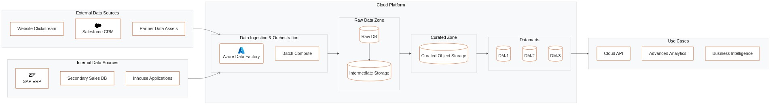
Reference Architecture
Enterprise logical data patterns
Logical Reference Architecture & Component Topology
Solution Advisory | Autonomous Bid Lifecycle Platform | AI Draft - For Internal Review Only

Slide 14
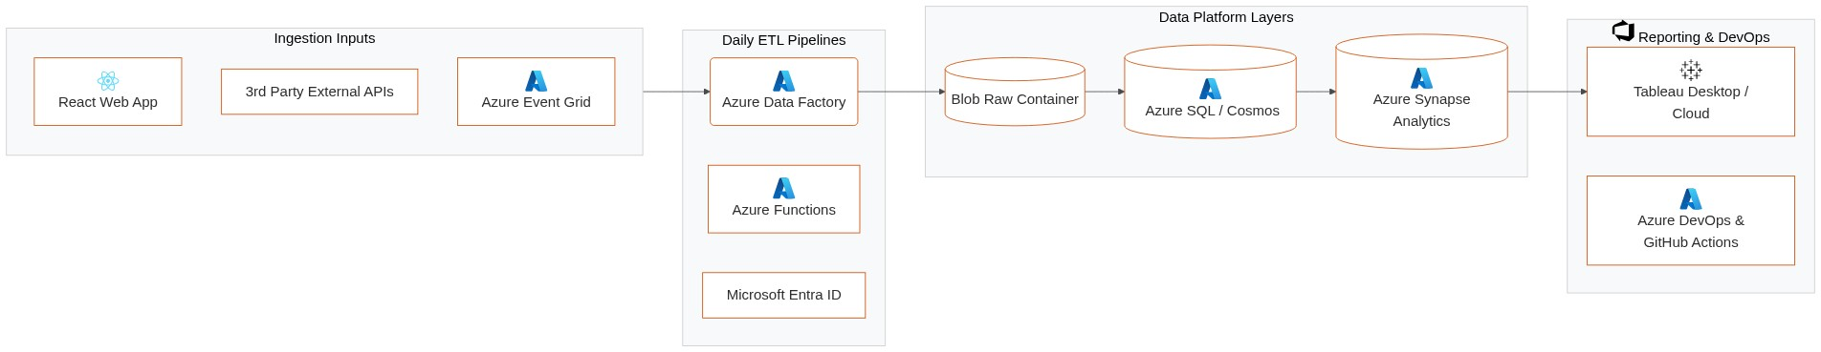
Landscape Architecture (Azure Cloud Platform)
Azure Native Services & Integration Topology
Azure Cloud Native Deployment Topology
Solution Advisory | Autonomous Bid Lifecycle Platform | AI Draft - For Internal Review Only

Slide 15
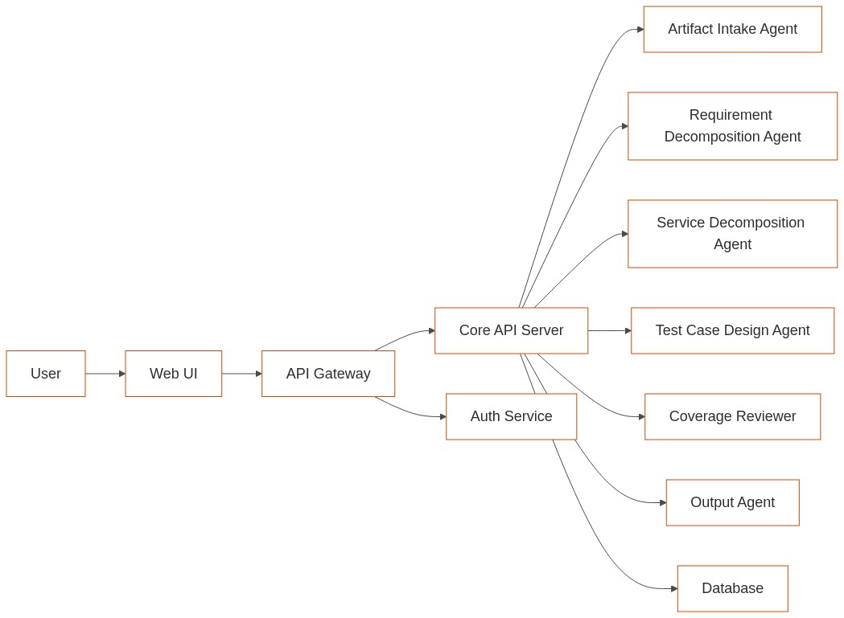
Case Study 1: Agile Test Automation Framework (Financial Services Firm in Europe)
Past credentials and successful delivery outcomes
High Level Summary
Technical Architecture
Business Problem
• Manual test case creation was time-consuming and error-prone.
• Lack of integration with CI/CD pipelines led to delayed feedback loops.
• Inconsistent test coverage across different modules.
Our Approach
• Developed an automated test generation framework using AI.
• Integrated the framework with existing CI/CD pipelines for continuous testing.
• Implemented a comprehensive dashboard for real-time test coverage and results tracking.
User uploads artifacts via Web UI.
Artifacts processed and tests generated in Core API Server.
Generated tests reviewed and packaged for implementation.
Key Technologies
Benefits/Outcome
• AI
• CI/CD Pipelines
• Dashboard
• Reduced test creation time by 70%.
• Improved test coverage consistency across modules.
• Enhanced feedback loops with continuous testing.
Solution Advisory | Autonomous Bid Lifecycle Platform | AI Draft - For Internal Review Only

Slide 16
Case Study 2: AI-Driven Test Case Generation for E-commerce (E-commerce Platform in North America)
Past credentials and successful delivery outcomes
High Level Summary
Technical Architecture
Business Problem
• High defect rates due to incomplete test coverage.
• Manual test case maintenance was inefficient and prone to errors.
• Delayed time-to-market due to lengthy testing cycles.
Our Approach
• Implemented an AI-driven test case generation system.
• Automated the integration of generated tests into existing CI/CD pipelines.
• Provided a user-friendly interface for artifact upload and test review.
User uploads artifacts via Web UI.
Artifacts processed and tests generated in Core API Server.
Generated tests reviewed and packaged for implementation.
Key Technologies
Benefits/Outcome
• AI
• CI/CD Pipelines
• Dashboard
• Reduced defect rates by 60%.
• Improved test case maintenance efficiency.
• Accelerated time-to-market with faster testing cycles.
Solution Advisory | Autonomous Bid Lifecycle Platform | AI Draft - For Internal Review Only

Slide 17
Thank You

